Slide 1
WVD Licensing

Slide 2




Windows Virtual Desktop EDU Licensing – 2 Scenarios WVD Can Host Both Client and Server OS’s – Licensing Approach is Different for Each
RD clients
Customer-managed
Windows Virtual Desktop Microsoft-managed Azure PaaS
Customer-managed Azure VMs
VMs
Web Access
Diagnostics
Windows 10 or Windows 7 Desktops
FIREWALL
FIREWALL
Gateway
Broker
Windows Server Running
RDS/RemoteApp
Azure SQL DB
M365 A3 A5 / VDA /Win10 EDU Licenses (details on next slide)
Requires RDS CAL w/SA (unchanged)

Slide 3
Many Clients are already eligible for WVD WVD Licensing Requirements
Clients in WVD
Customers are eligible to access Windows 10 single and multi session and Windows 7 with Windows Virtual Desktop (WVD) if they have one of the following licenses*:
Microsoft 365 E3/E5
Microsoft 365 A3/A5/Student Use Benefits
Microsoft 365 F1
Microsoft 365 Business
Windows 10 Enterprise E3/E5
Windows 10 Education A3/A5
Windows 10 VDA per user
Servers in WVD
Customers are eligible to access Server workloads with Windows Virtual Desktop (WVD) if they have one of the following licenses:
RDS CAL license with active Software Assurance (SA)
.
Customers pay for the virtual machines (VMs), storage, and networking consumed when the users are using the service
*Customers can access Windows Virtual Desktop from their personal non-Windows Pro endpoints if they have a Microsoft 365 E3/E5/F1, Microsoft 365 A3/A5 or Windows 10 VDA per user license.
Notes:
So here’s another the good news. We have made eligibility very easy for all customers to be eligible for WVD.
Most of your customers will already own the required licenses to access Windows Virtual Desktop. If your customer has an existing or new M365 or Windows E3/E5 licenses and Windows Virtual Desktop would be available in F1, Business and in CSP as well. The customers that have M365 oe E3 are already eligible for Windows 10 multi-session and all the benefits of WVD.
On the Server side, any customer that has a RDS CAL with SA are today eligible for WVD. As shared before, all WVD customers pay Linux rates in Azure.

Slide 4
Scenario 1: Accessing Windows 10 and 7 in WVD Reference: https://azure.microsoft.com/en-us/pricing/details/virtual-desktop
EDU Customers are eligible to access Windows 10 and Windows 7 in WVD from Windows if the end-user has one of the following EDU licenses assigned to them:
Microsoft 365 A3 /A5
Microsoft 365 A3/A5 Student Use Benefit SKUs
Windows 10 VDA per user license
Windows 10 Education A3/A5*
EDU Customers can access Windows Virtual Desktop from their non-Windows endpoints if they have a Microsoft 365 E3/E5, Microsoft 365 A3/A5/Student Use Benefit or Windows 10 VDA per user license
* Paid student license – Student Use Benefit does not apply

Slide 5
Scenario 2: Accessing Windows Server RDS and Windows Server RemoteApp in WVD Reference: https://azure.microsoft.com/en-us/pricing/details/virtual-desktop
EDU Customers are eligible to access Windows Server 2012 R2 and newer running RDS or Published Windows Server 2012 R2 RemoteApps in Azure and access them via WVD from any endpoint, Windows or non-Windows, if the end user the following license assigned to them:
An RDS CAL license with active Software Assurance (SA)

Slide 6
EDU Licensing Summary - Overall Approach Summary
M365 A3 and A5 Subscriptions are the primary licensing vehicle for delivering value and simplifying licensing across EDU solutions
Eliminates other licensing barriers & makes M365 A3/A5 with associated SUB even more attractive
Does not modify or change existing RDS CAL requirements for solutions/deployments that use Windows Server
Substantially less expensive than competitors’ approaches to EDU Virtualization challenges

Slide 7
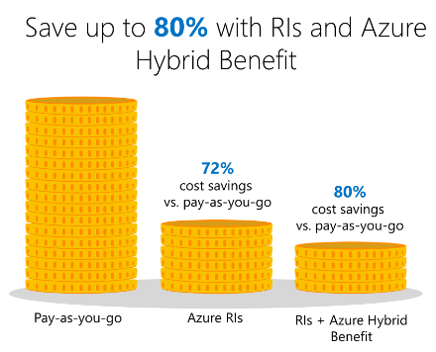
Costs Considerations – What do I spend to use WVD??
Licensing (see previous slides for scenarios)
Use the WVD Cost Calculator to factor in the ongoing Azure real estate cost:
VM uptime/execution
Bulk of the costs - “right size” the VMs using Azure Advisor
Mitigate with Reserved Instances (options in Cost Calculator)
Hybrid Use Benefit applied automatically – no Windows OS fees
Use Azure start/stop automation to shut down outside of SLA hours
Use WVD scale up / scale down based on demand to reduce uptime costs & dynamically respond to load demands
Storage for VMs and Profiles
DCs/DNS/ADFS in Azure
Profile File server
Networking costs

Slide 8
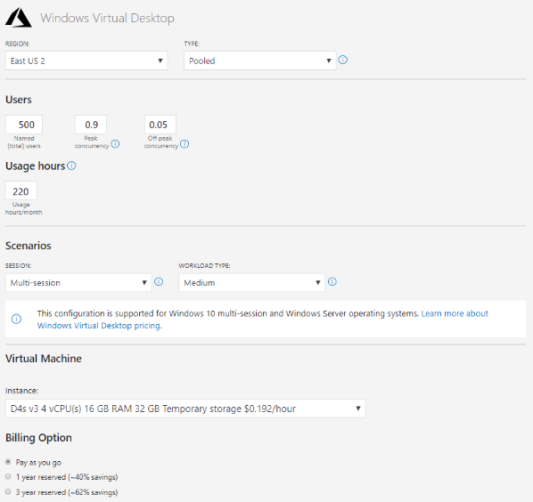
Resources – Planning & Pre-work
Windows Virtual Desktop pricing
WVD Cost Calculator
WVD Bandwidth Planning
Windows Virtual Desktop Experience Estimator

Slide 9
Sample Pricing

Slide 10
WVD Walkthrough

Slide 11
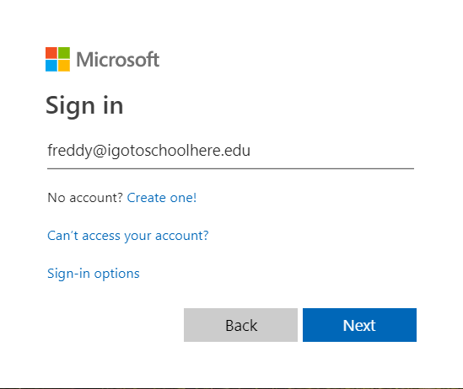

How Do Students Use WVD?
Student Opens a Web Browser, Connects to Azure WVD Portal & logs in
Notes:
Why this is goodness:
HTML5- compatible Web Browser (Chrome, Firefox, Safari, Edge, etc.)
OS of the Device generally irrelevant
Username & Password are all the student needs to know (AD & Azure AD)
Clients for iOS, Android, & Windows available too

Slide 12
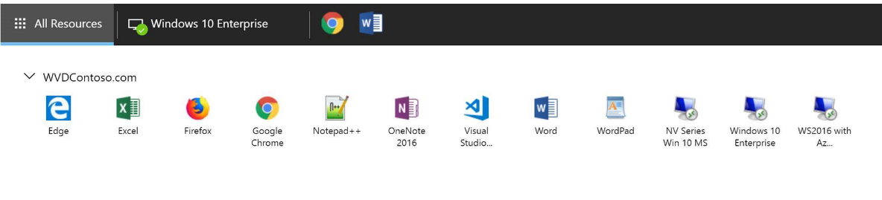
How Do Students Use WVD?
WVD Portal: Applications & Desktops published to the user’s ID
Apps
Desktops
Notes:
Why this is goodness:
IT stood this up and published 1:many
Leveraged M365 A3/A5 licenses
All systems managed via AD Group Policy

Slide 13
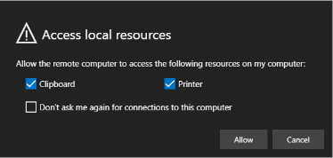
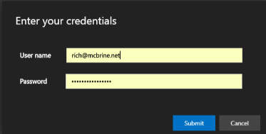
How Do Students Use WVD?
Student Clicks to Open a Desktop
Student Prompted for Printer/Clipboard and Creds – Logging in to Azure AD*
Apps
Desktops

Slide 14
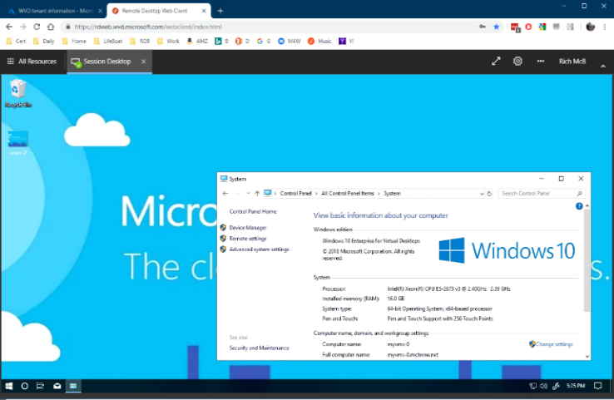
How Do Students Use WVD?
Student connected to their Windows 10 VM In Azure
Student’s settings followed them (FSLogix)
Cached Outlook
Cached OneDrive
Wallpaper, desktop files, customizations, etc.
Notes:
Minimize costs:
Only pay for supporting cast of VMs while running (think annual testing)
Leverage existing M365 A3/A5 & SUB license benefits (wow, that was easy)
GPU-ready – no need to buy
Provide Well-Managed solution:
Leverage existing Group Policies & Win10 Management tools
Win10 - minimal app compatibility issues
Supports “My Lab is Where I Am”
HTML5 Browser & Internet access offer ubiquitous access

Slide 15


WVD Use Cases In Education
Elastic Student
& Faculty Support
Specialized
workloads
Student turnover per semester
Seasonal faculty/class requirements
BYOD and mobile support
Seasonal Testing w/locked down Windows 10
Access to class-specific Apps or Desktops
Design and engineering (GPU)
Legacy Win32 apps
Win10-only apps
Software dev test (+offshore)

Slide 16
WVD Value for EDU Clients
Time to market – deploy in minutes
Procurement challenges
Hardware investment/upgrade/maintenance savings
GPU acquisition and support horizon
Seasonality of demand – scale when needed
Access for Students & Faculty is just username/password and:
Any HTML5-certified web browser
A platform-specific full WVD client
Leverages existing Group Policies & Win 10 management tools
Minimal App Compatibility challenges
Desktop App Assure provides application remediation assistance at no additional cost
aka.ms/DesktopAppAssure

